Slide 1
Predictive Maintenance of Industrial Machinery
MACHINE LEARNING PROJECT
Presented By:
Dhilipkumar R- M Kumarasamy college of Engineering-ECE
GITHUB LINK:https://github.com/Dhilip2004

Slide 2
OUTLINE
Problem Statement (Should not include solution)
Proposed System/Solution
System Development Approach (Technology Used)
Algorithm & Deployment
Result (Output Image)
Conclusion
Future Scope
References

Slide 3
Problem Statement
Develop a predictive maintenance model for a fleet of industrial machines to anticipate failures before they occur. This project will involve analyzing sensor data from machinery to identify patterns that precede a failure. The goal is to create a classification model that can predict the type of failure (e.g., tool wear, heat dissipation, power failure) based on real-time operational data. This will enable proactive maintenance, reducing downtime and operational costs.

Slide 4
Proposed Solution
The proposed system aims to address the challenge of predicting the type of failure in industrial machines before it occurs. This enables timely maintenance and reduces operational disruptions. The solution will involve using machine learning algorithms to analyze sensor data and identify patterns associated with different types of failures. The solution will consist of the following components:
Data Collection:
Gather historical sensor data from the industrial machines including vibration, temperature, pressure, rotation speed, and torque.
Collect machine status logs indicating operational conditions, failure events, maintenance records, and component usage.

Slide 5
Proposed solution
Data Preprocessing:
Clean and preprocess the data to remove missing values, noise, duplicates, and inconsistent records.
Perform feature engineering to extract meaningful features such as rolling averages, thresholds, and change detection patterns that correlate with failure types.
Machine Learning Algorithm:
Implement classification algorithms such as Random Forest, XGBoost, or Neural Networks to classify the type of failure.
Experiment with time-series or sequential models (e.g., LSTM, GRU) to capture temporal dependencies in sensor data.

Slide 6
Proposed solution
Deployment:
Develop a web-based dashboard or mobile application using IBM Cloud Lite services for real-time prediction and alerts.
Automate model inference to run on real-time data streams and trigger early warning notifications.
Ensure system scalability and reliability, considering factors such as processing time, API response time, and uptime.

Slide 7
System Approach
The "System Approach" section outlines the overall strategy and methodology for developing and implementing the power system fault detection and classification. Here's a suggested structure for this section:
System requirements:
IBM Cloud (mandatory)
IBM Watson Studio for model development and deployment
IBM Cloud Object Storage for dataset handling

Slide 8
Algorithm & Deployment
ALGORITHM & DEPLOYMENT
🔹 Algorithm Selection: Random Forest Classifier (or SVM based on performance)
🔹 Data Input: Voltage, current, and phasor measurements from the dataset
🔹 Training Process: Supervised learning using labeled fault types
🔹 Prediction Process: Model deployed on IBM Watson Studio with API endpoint for real-time predictions

Slide 9
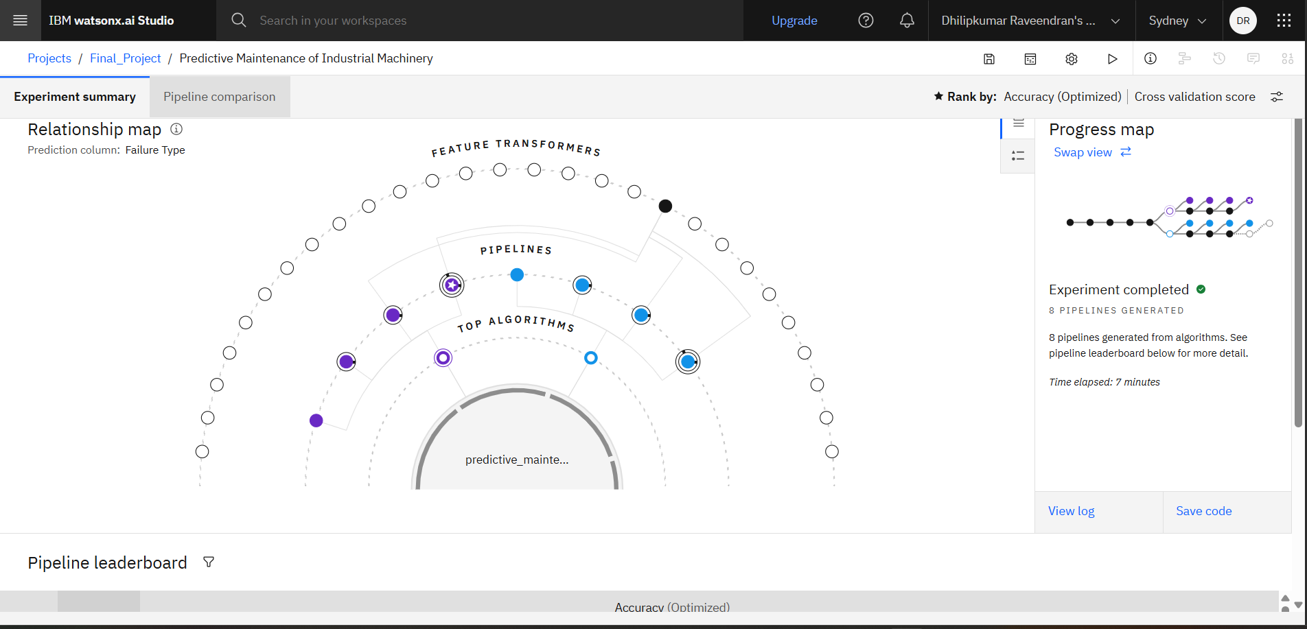
Result

Slide 10
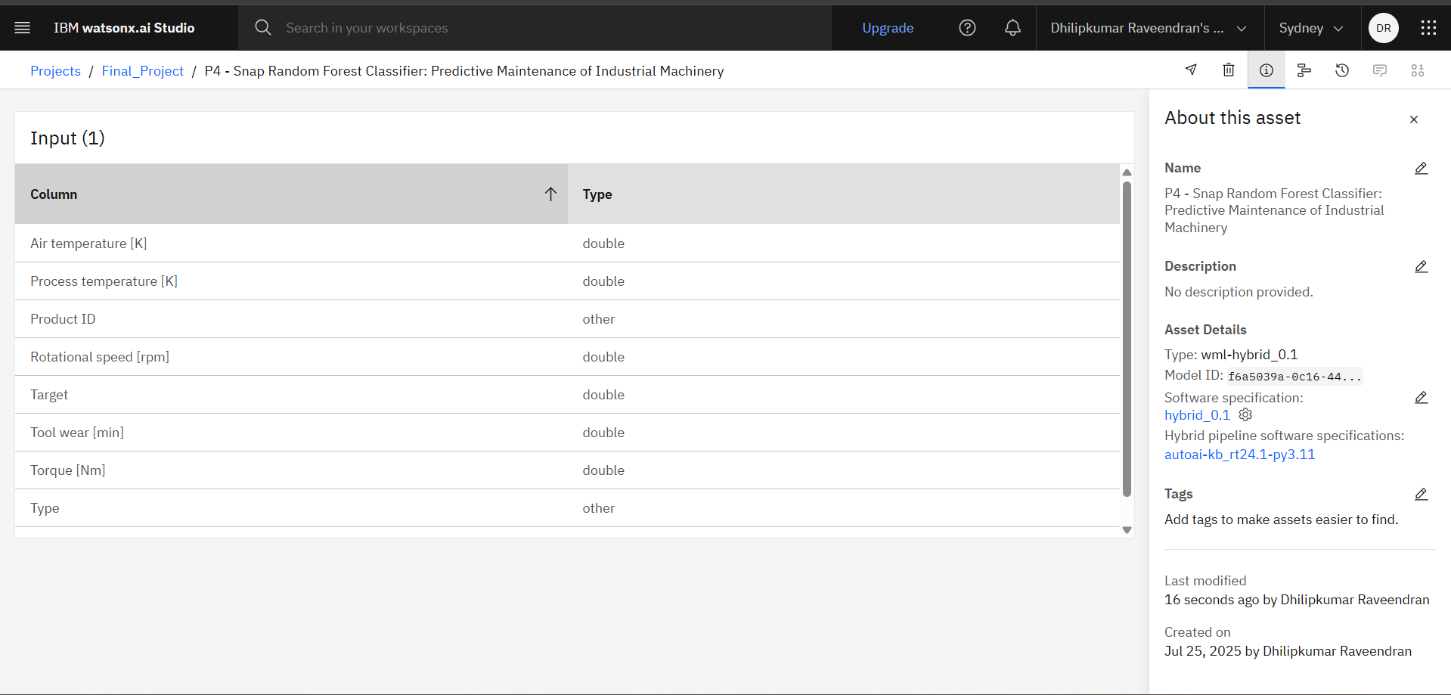
Result

Slide 11
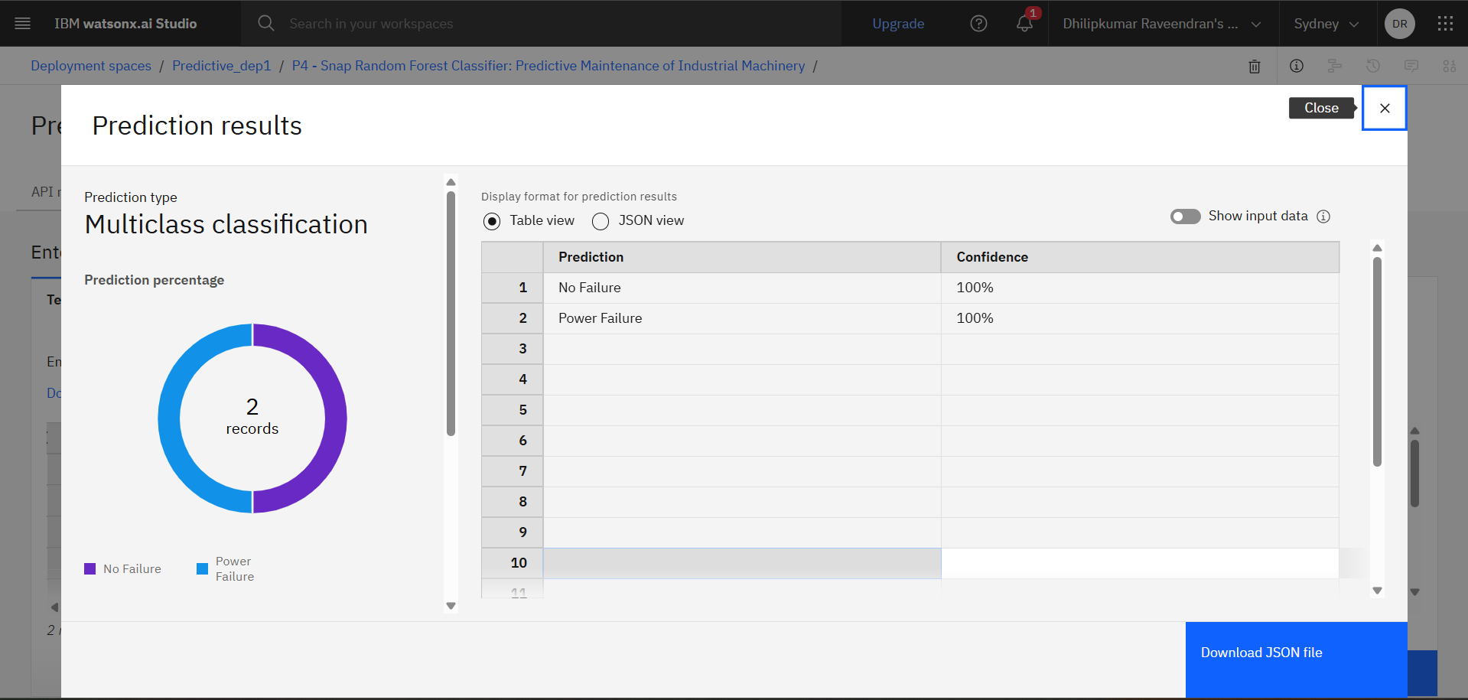
Result

Slide 12
Conclusion
The predictive maintenance solution built on IBM Cloud provides a scalable and reliable approach to anticipate industrial machinery failures.
The model enables proactive maintenance, reducing downtime, repair costs, and unexpected failures.
Demonstrated the potential of AI + Cloud in enhancing traditional mechanical systems through smart maintenance planning.
Future enhancements may include integration with IoT devices, real-time dashboards, and expanding the model to cover diverse machine types across the industry.

Slide 13
Future scope
The proposed system provides a strong foundation for real-time fault detection in power systems. However, there are several opportunities for future enhancement:
Integration with IoT Devices Real-time data acquisition can be enhanced by integrating IoT-enabled sensors directly with the model for live fault detection and faster response.
Expansion to Multiple Fault Types The current model can be extended to classify more complex and rare fault types, improving grid reliability and robustness.
Use of Advanced Deep Learning Models Incorporating deep learning architectures such as CNNs or LSTMs could improve accuracy, especially in high-dimensional time-series data.

Slide 14
References
IBM Cloud – Official Website https://www.ibm.com/cloud
IBM Watson Studio – Model Development and Deployment https://www.ibm.com/cloud/watson-studio
IBM Cloud Object Storage – Dataset Handling https://www.ibm.com/cloud/object-storage
IBM Machine Learning Documentation https://www.ibm.com/docs/en/cloud-paks/cp-data/4.6.x?topic=services-machine-learning
Kaggle Dataset for Predictive Maintenance (if used): https://www.kaggle.com/datasets/shivamb/machine-predictive-maintenance-classification

Slide 15
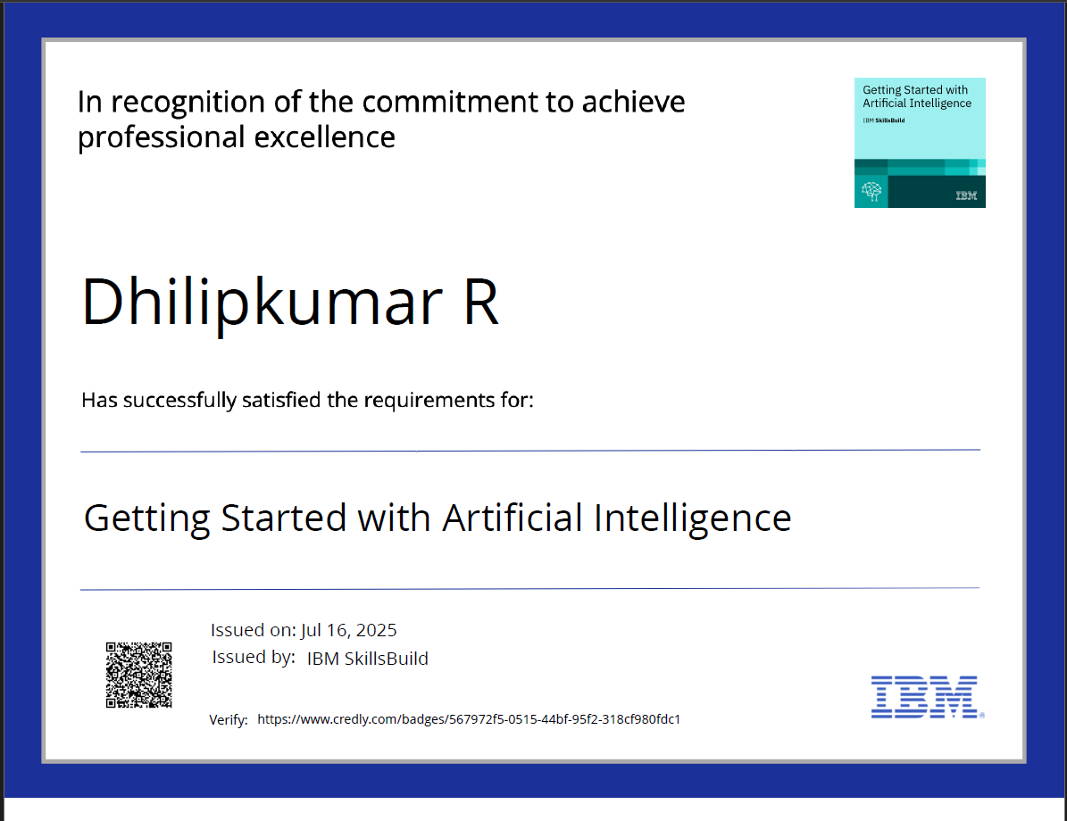
IBM Certifications

Slide 16
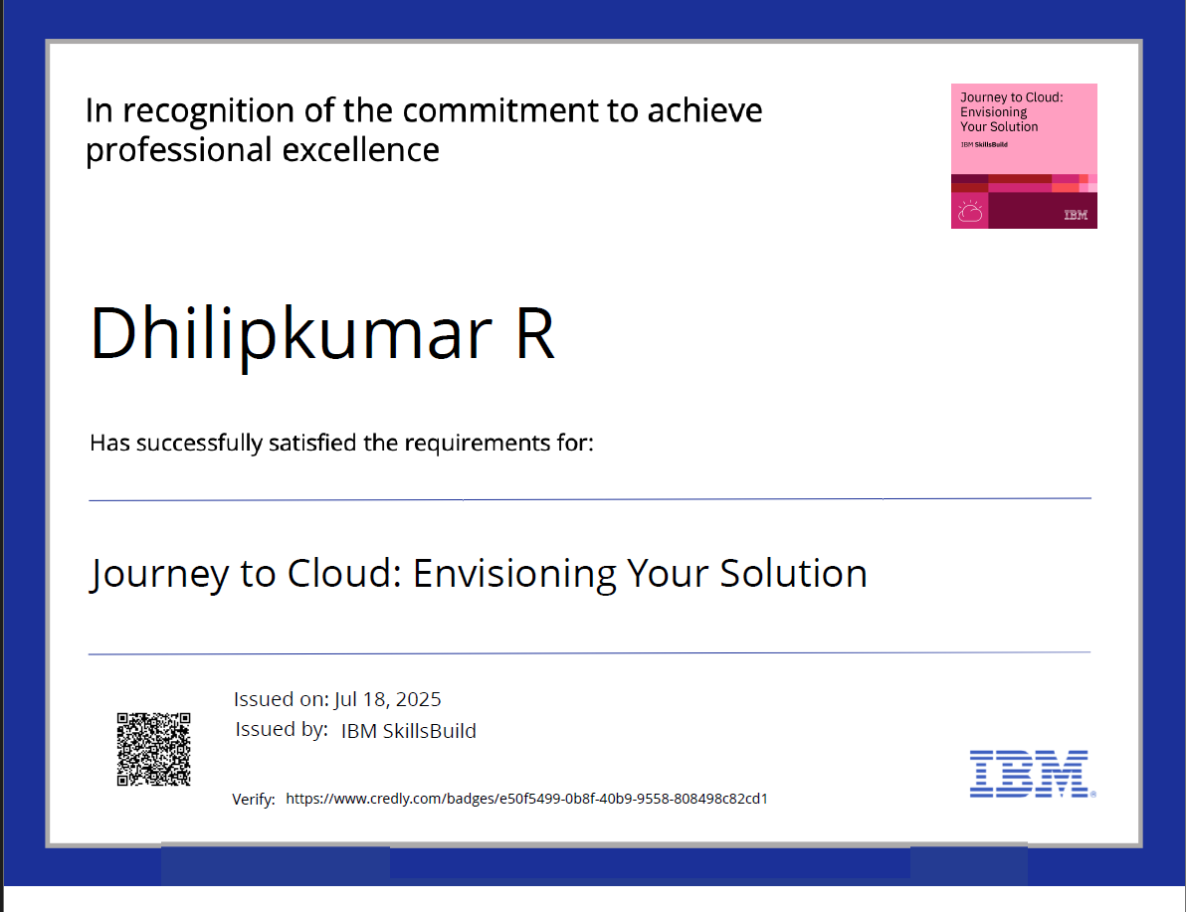
IBM Certifications

Slide 17
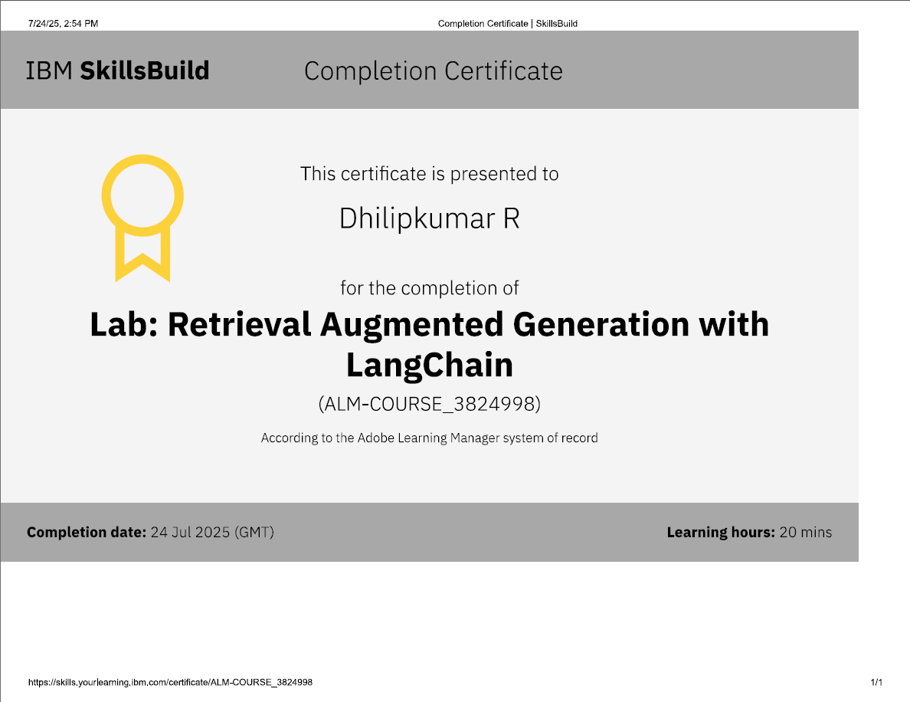
IBM Certifications

Slide 18
THANK YOU

